Slide 1
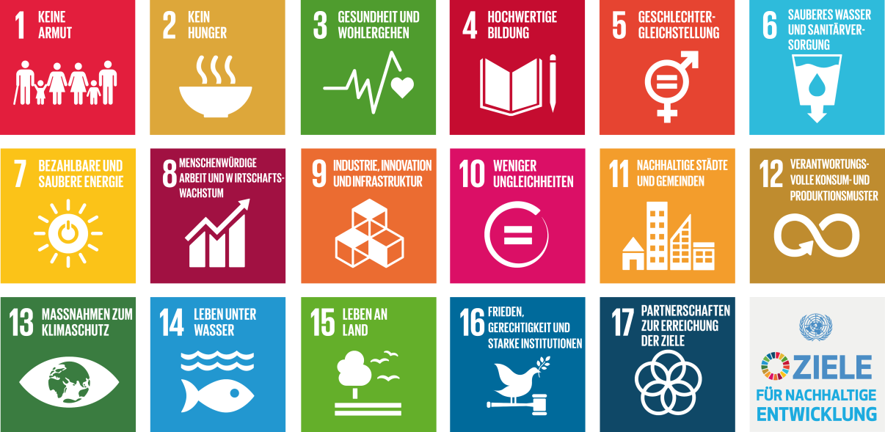
Sustainable Development Goals Paris 2015

